Slide 1
THE NEED FOR CONFIDENTIAL REPORTING
Captain Winston Singh CMMar
CHIRP Maritime Ambassador

Slide 2
Key Discussion Points
The Role of CHIRP
What are the issues?
Financial Cost of issues
Safety investigations
Findings of Investigations
The Reporting Process

Slide 3
The Role of CHIRP
Confidential. Independent. Impartial
Confidential reporting system – a safe space to report concerns
Work with company and stakeholders to address issues
Undertake data analysis and trend identification
Promote a ‘just’ culture
Reports can be made online, via app, email, telephone, web chat

Slide 4
We are …
VOLUNTARY
Voluntary submission of reports concerning events related to safety for the purpose of system alerting, understanding and learning
CONFIDENTIAL
Protection of identity through disidentification of persons, companies, and any other identifying information
INDEPENDENT
Trusted, unbiased dissemination of safety information and advice
JUST CULTURE
Non-judgemental safety net for reporting occurrences that might not otherwise be reported
Improving Safety at Sea

Slide 5
OK, but ...
We already have our own reporting system. Why use CHIRP?
The CHIRP database reflects the experience and learning of the wider maritime industry, not just that of your company. We help share ‘best practice’ across company and sector boundaries worldwide!
Won’t telling you about our incidents incur reputational risk?
CHIRP assiduously removes all identifying information prior to publication and we never reveal the details of people, places, vessels or companies involved.
We share the learning; we don’t point the finger.
How Confidential are you, really?
We have operated for 22years with 0 breaches of confidentiality!
Improving Safety at Sea

Slide 6
What are the issues?
A maritime worker dies every 14 minutes
>75% of incidents attributed to human error
>1500 shipping containers lost pa
543 cargo-related hazard deaths pa
2,700 shipping incidents globally
>60 large ships lost pa
56 enclosed spaces deaths pa
1000 passenger ferry deaths pa
36,000 fisher deaths pa
Notes:
Maritime transport is one of the safest means of passenger transport overall, but seafaring remains a dangerous profession.
Fatality rates are up to 12 times higher than in the general workforce, and in some specific sectors such as commercial fishing, even higher

Slide 7
The financial cost of incidents
There are 2,700 maritime incidents pa…
Minor (collisions, pollution fines, cargo damage) $15-500k
Moderate (fires, injury, port damage) $0.5-10m
Severe (groundings, oil spills, loss of life) $10-100m
Catastrophic (total loss, major environmental damage)
Ever Given grounding ($400m per hr) $2 bn
Baltimore Bridge $4 bn
Cost per incident: $1-10m mean, $15-50k mode

Slide 8
Objectives of a safety investigation
PREVENT
IMPROVE
LEARN
MSC.255(84)/A.1075
A.884(21) HF Guidance
No regulatory requirement!
‘…to prevent similar
casualties and incidents
in the future’
“We don’t learn from experience, we learn from reflecting on experience”
(John Dewey)
‘To improve…the lives of personnel, and more efficient and safer operations’

Slide 9
Why we need to share
“May you live in ‘interesting times”!
Novel fuels – transition risks & inherently more hazardous
Autonomy – reliability, integration, crewed/uncrewed vx interface
AI – cyber security risks, inadvertent ‘decisions’
Challenges? Training, familiarity, technology integration, regulatory alignment, standardisation, trust, pace of change, existing safety cultures, and most importantly reluctance to share (fear of reputational damage)

Slide 10
Why aren’t reports raised?
300
Near-Misses
29
Incidents
1
Death
…fear of rejection
…fear of ridicule
…fear of reprisals (personal and organisational)
…different reporting thresholds
…no common reporting system
…no common taxonomy
…no perceived benefit

Slide 11
Perception
Reality
Notes:
Safety Culture is a vital concept for shipping organizations that wish to reduce the risk of incidents. According to Hudson, there are 5 aspects of safety culture – Leadership, Respect, Mindful, Just and Learning.
Focusing on Safety Culture, Professor. Patrick Hudson developed a theoretical model know as the “HUDSON LADDER”. It plots the development of an organization’s safety culture, the higher the level, the bigger the trust and information sharing.
It provides a framework for organizations in shipping to assess their safety maturity and identify areas for improvement. The most important ingredient in moving up the ladder is the commitment and actions of leadership especially senior leaders.
James Reason – 5 elements that constitute a safety culture – informed, learning just, reporting and flexible. (Managing the risks of organizational accidents). An atmosphere of trust where people feel comfortable reporting errors and near misses without blame and errors and unsafe acts will not be punished if not intentional.

Slide 12
Our Findings
SHIELD Factor | Deadly Dozen
Acts
Incorrect decision or plan | Local Practices
No transmission of information | Communication
Workaround in normal conditions | Deviation
No/wrong/late visual detection | Situational Awareness
No or late detection by other means | Situational Awareness
Preconditions
Inattention | Distraction
Risk underestimation | Complacency
No cross-check or speaking up | Alerting
Operational Leadership
Authority gradient | Communication
Inadequate supervision | Teamwork
Organisation
Safety culture | Culture
Insufficient personnel | Pressure
Equipment design | Design
Safety management | Culture
Common Incident Characteristics:
Crew taking short-cuts (Work-arounds in normal conditions) and did not detect that the situation was changing.
Why?
Crew distracted by high workloads, and not fully aware of the risks. Team members did not speak up (alert) about defects or other issues
Many incidents start in the Board Room!
Improving Safety at Sea

Slide 13
Our Findings – (Continued)
SHIELD Factor | Deadly Dozen
Acts
Incorrect decision or plan | Local Practices
No transmission of information | Communication
Workaround in normal conditions | Deviation
No/wrong/late visual detection | Situational Awareness
No or late detection by other means | Situational Awareness
Preconditions
Inattention | Distraction
Risk underestimation | Complacency
No cross-check or speaking up | Alerting
Operational Leadership
Authority gradient | Communication
Inadequate supervision | Teamwork
Organisation
Safety culture | Culture
Insufficient personnel | Pressure
Equipment design | Design
Safety management | Culture
Common incident characteristics:
Why?
Not adequately briefed on risks; supervision lacking. Did not feel empowered to speak up when they saw something amiss.
Why?
Vessel/people running ‘efficiently’ ie under-resourced. Equipment defective, missing or had design issues. Safety culture did not champion issues being raised, or did not react appropriately when they were.
Improving Safety at Sea

Slide 14
Our Reach
Ambassador locations
83 in 39 administrations
Notes:
CHIRP has 83 active ambassadors in 39 administrations who are in the countries coloured dark orange

Slide 15
The Reporting Process
Reports received via website, app or email
We liaise with reporter, gather further detail, then disidentify
Maritime Advisory Board meets quarterly to assess reports
Publication of Maritime FEEDBACK newsletter online, in app, in hard copy – in 8 languages
Annual digest published every April

Slide 16
Reporting
Report safety incidents involving
You
Report when
Don’t report
Your organization or your vessel
Other people you deal with
Other reporting systems haven’t worked
Others could benefit from a ‘lesson identified’
You are concerned about reprisals
Non-safety incidents
Personality clashes
Industrial relations issues
Notes:
Report 3 ways: Go to website, click and submit report / Dowload app on android or apple / email “reports@chirp.co.uk.”

Slide 17
Reporting channels
Submit a Report – CHIRP
Who’s On Chat: Start Chat Session
+44 203 876 8588

Slide 18
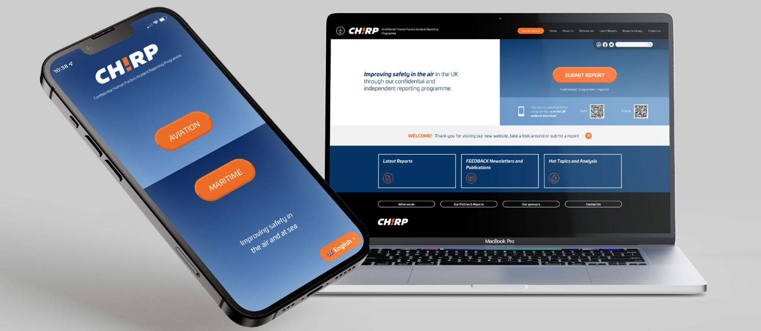

Slide 19
SUMMARY
Chirp advocates for a “just” culture – one that encourages reporting without fear of punishment
The focus is on what happened not who’s to blame
Each report is a chance to prevent a disaster
Your voice can change the course of someone’s life at sea don’t underestimate that.

Slide 20
Thank you !
“Learn from the mistakes of others. You can’t live long enough to make them all yourself.”
Oliver Wendell Holmes

